Slide 1

SCHOOL OF ENGINEERING
DEPARTMENT OF COMPUTER SCIENCE AND ENGINEERING
B.E-CSE –Final Year (8th Semester)
Academic Year: 2025-2026
PROJECT PHASE II

Slide 2
ICU Patient Risk Level Monitoring System Using Unsupervised Learning Approaches
SUBMITTED BY :
Rajesh D (21602155)
Rajalakshmi R (21602154)
Christina Evangeline J (21602111)
INTERNAL GUIDE :
Dr.A.Saritha
Associate Professor(CSE)

Slide 3
TABLE OF CONTENT
INTRODCUTION
ABSTRACT
OBJECTIVE
IV. PROBLEM STATEMENT
V. LITERATURE SURVEY
VI. EXISTING SYSTEM
VII. PROPOSED SOLUTION
REQUIREMENTS
ARCHITECTURE

Slide 4
INTRODUCTION
In hospitals, especially in Intensive Care Units (ICUs), doctors and nurses must continuously monitor patients to ensure their condition does not worsen. However, with a high volume of patients and large amounts of medical data, tracking every change in real time can be challenging. Delays in detecting critical conditions can affect patient recovery and increase the risk of complications.
To address this issue, the ICU Patient Risk Level Monitoring System is designed using supervised learning techniques to analyze patient data and predict risk levels. By processing vital signs, medical history, oxygen levels, and other clinical parameters, the system can generate real-time alerts when a patient’s condition becomes critical.
This project utilizes machine learning algorithms such as K-Nearest Neighbors (KNN), Decision tree classifier to train models on ICU patient data. The primary objective is to build an efficient and accurate risk prediction model that enhances clinical decision-making and improves patient outcomes.
Currently, many hospitals rely on manual monitoring and traditional risk prediction methods, which may not always be fast or precise. Automating this process with machine learning can reduce human errors and ensure timely medical intervention. In the future, this technology can be integrated with IoT devices to enhance ICU monitoring, making critical care management more advanced and reliable.

Slide 5
ABSTRACT
Modern Intensive Care Units (ICUs) provide continuous monitoring of critically ill patients who are susceptible to many complications affecting morbidity and mortality. ICU settings require a high staff-to-patient ratio and generate a vast volume of data. For clinicians, the real-time interpretation of this data and decision-making is a challenging task. Machine Learning (ML) Algorithms like K-Nearest classifier, Decision Tree, Support vector classifier are making significant progress in ICUs by enabling the early detection of high-risk events due to increased processing power and freely available datasets such as the Medical Information Mart for Intensive Care (MIMIC).This project aims to explore New ML techniques like K-Nearest Neighbors (KNN), Support Vector Machine (SVM), and Decision Tree Classifier in ICU settings using MIMIC data. The approach will assemble qualified articles to gain insights into areas of application, clinical variables used, and treatment outcomes, which can pave the way for further adoption of this promising technology in routine clinical decision-making. The lessons learned from research will provide guidance to researchers on the application of ML techniques, increasing their adoption in healthcare. The ICU patient risk level monitoring system will play a crucial role in improving patient safety, optimizing resource allocation, and enhancing clinical decision-making in intensive care settings. By continuously monitoring and analyzing patient data, this system will provide valuable insights to help healthcare providers intervene promptly and prevent adverse outcomes.

Slide 6
OBJECTIVE
The main objective of this project is to develop a Machine Learning-based ICU Patient Risk Level Monitoring System that can predict patient risk levels in real-time. By using supervised learning techniques, the system will analyze large-scale datasets like MIMIC to train accurate prediction models. This will help doctors and nurses identify high-risk patients early, allowing for timely medical intervention. Ensuring quick response to critical conditions can improve patient outcomes and reduce ICU mortality rates.
Another important goal is to enhance early detection of critical health conditions by analyzing key clinical variables. Vital signs, oxygen levels, medical history, and lab results will be processed using machine learning models. These models will detect patterns that indicate potential complications before they become severe. This automation will reduce delays in diagnosis and minimize human errors in ICU monitoring.
The project also aims to improve clinical decision-making by providing real-time risk assessments to healthcare professionals. Traditional monitoring methods rely on manual observation, which can be time-consuming and inconsistent. By using AI-driven insights, the system will support medical staff in making faster and more accurate decisions. This can optimize ICU resource management and improve patient care quality.
Finally, this project seeks to facilitate the integration of machine learning in ICU environments by evaluating different ML approaches. The effectiveness of various models in predicting patient risks will be analyzed and compared. Insights from this research can help hospitals and researchers adopt AI-based solutions in critical care settings. A scalable and efficient system can contribute to better patient monitoring and hospital management.

Slide 7
PROBLEM STATEMENT
Intensive Care Units (ICUs) require continuous monitoring of critically ill patients, but tracking large amounts of real-time data is challenging. Traditional monitoring relies on manual observation, which can lead to delays in detecting critical health conditions. These delays increase the risk of complications, making early intervention difficult for healthcare professionals.
Existing ICU systems struggle to analyze complex patient data, including vital signs, lab results, and medical history. Limited medical staff and resource constraints make it harder to provide timely and personalized care. Without an advanced predictive system, subtle warning signs may go unnoticed, leading to poor patient outcomes.
This project proposes an ICU Patient Risk Level Monitoring System using supervised learning techniques to predict patient risk levels. Machine learning models will analyze patient data and provide real-time alerts for early intervention. Automating risk assessment can improve patient safety, reduce ICU workload, and enhance hospital efficiency.

Slide 8
LITERATURE SURVEY
S.No | Title | Author(s) | Description | Advantages | Disadvantages
1. | Edge AI for Real-Time ICU Patient Monitoring: A scalable Approach | Roberts, B., & Adams, T., (2023) | Proposes an Edge AI-based ICU monitoring system for real-time patient data analysis | Reduces latency in decision-making. | Limited processing power on edge devices.
2. | Enhancing ICU Monitoring with AI-Driven Anomaly Detection | Zhang, L., & Wang, H.(2023) | Proposes as AI-based anomaly detection system to identify sudden patient deterioration. | Reduces false alarms in ICU settings. | May miss rare anomalies due to model biases.
3. | Reducing False Alarms in ICU Monitoring Using Hybrid AI Models | Wang, X., & Zhao, J. (2023) | Develops a hybrid AI model to reduce alarm fatigue in ICU monitoring. | Improves alarm precision, reducing unnecessary alerts. | ReMay require continuous model retraining for reliability.
4. | Edge AI for Real-Time ICU Patient Monitoring: A Scalable Approach | Roberts, B., & Adams, T. (2023) | Proposes an Edge AI-based ICU monitoring system for real-time patient data analysis. | Reduces latency in decision-making. | Limited processing power on edge devices.
5. | Federated Learning for Privacy-Preserving ICU Data Analysis | Miller, A., & Thompson, J. (2022) | Applies federated learning for secure and decentralized ICU data analysis. | Protects patient data privacy while enabling AI training. | Requires significant computational power.

Slide 9
S.No | Title | Author(s) | Description | Advantages | Disadvantages
6. | Federated Learning for Privacy-Preserving ICU Data Analysis | Miller, A., & Thompson, J. (2022) | Applies federated learning for secure and decentralized ICU data analysis. | Protects patient data privacy while enabling AI training. | Requires significant computational power.
7. | Multimodal Data Fusion in ICU Patient Monitoring Systems | Carter, E., & Mitchell, L. (2022) | Combines various data sources (vitals, imaging, EHR) for comprehensive ICU monitoring. | Enhances diagnostic accuracy through multi-source data. | High complexity in data integration and processing.
8.
9. | Deep Reinforcement Learning for Predictive ICU Treatment Planning | Nakamura, Y., & Suzuki, K. (2020) | Uses reinforcement learning for ICU treatment optimization. | Improves personalized treatment strategies. | Requires extensive training data and simulations.
10. | IoT-Based Vital Signs Monitoring for Critical Care Patients | Lee, C., & Kim, D. (2020) | Discusses the integration of IoT sensors for continuous patient monitoring in ICUs. | Enables real-time remote monitoring. | RData privacy and security concerns.

Slide 10
EXISTING SYSTEM
Current ICU patient risk monitoring systems mainly rely on Electronic Health Records (EHR) and Machine Learning (ML) techniques to predict patient conditions. These systems process large volumes of patient data, including vital signs, laboratory results, and medical history, to detect early signs of deterioration.
However, existing models often struggle with accurately analyzing multi-dimensional time-series data, which affects prediction accuracy. Many approaches focus on either temporal trends or clinical variable relationships, but not both together, leading to incomplete patient analysis and delayed risk assessment.
Various technologies have been explored in research papers, including Graph Neural Networks (GNNs), Support Vector Machines (SVMs), Random Forest, and Deep Learning models. Some studies use Heterogeneous Graph Neural Networks (HGNNs), which require manual selection of Meta-Paths, making them less adaptable and time-consuming to configure.
Other models, like Support Vector Machines work well for structured data but struggle with real-time, high-dimensional ICU datasets. Deep learning models have shown promise in improving predictions, but they require large computational resources, making real-time deployment challenging for most hospitals.

Slide 11
A major limitation in the existing system is the lack of real-time deployment. Many models are developed and tested using publicly available datasets such as MIMIC-III, but they are not integrated into actual ICU environments. This gap between research and practical implementation limits the effectiveness of these models in critical situations.
Additionally, most models do not account for individual patient variations, meaning their predictions may not always generalize well to different hospital settings. The dependence on predefined rules and manual feature selection further reduces the flexibility of existing approaches.
Comparing various research studies, it is clear that while ML-based ICU monitoring systems have improved patient risk prediction, they still have limitations in terms of accuracy, computational efficiency, and real-time usability.
Many existing methods require extensive feature engineering, making them difficult to scale across different ICU environments. The lack of automated feature selection and model optimization remains a key challenge.
To overcome these issues, a more advanced system with real-time data processing, improved model adaptability, and efficient deployment strategies is needed for better ICU patient monitoring and risk assessment.

Slide 12
PROPOSED SOLUTION:
Machine Learning for ICU Risk Prediction:
This project introduces an ICU Patient Risk Level Monitoring System using classification and ensemble learning techniques. It analyzes real-world ICU patient data from the MIMIC dataset, which includes vital signs, medical history, lab results, and medication records. The system applies K-Nearest Neighbors (KNN), Support Vector Machine (SVM), and Decision Tree Classifier to improve prediction accuracy and enable early detection of critical conditions.
Data Preprocessing and Feature Engineering:
To ensure high-quality predictions, data preprocessing techniques will handle missing values, duplicates, and normalization. Feature selection will identify key clinical variables influencing patient risk levels. The system will use exploratory data analysis (EDA) with Matplotlib and Seaborn to detect trends in ICU data from MIMIC. Outlier detection and handling will enhance data consistency, ensuring reliable model performance.

Slide 13
Optimized Machine Learning Algorithms:
The system integrates KNN for similarity-based risk assessment, SVM for precise classification, and Decision Trees for structured decision-making will enhance prediction stability by combining multiple classifiers. These models will continuously learn from ICU records in the MIMIC database, improving accuracy over time.
Model Evaluation & Deployment with Django:
Performance Assessment: Evaluate the trained models using accuracy, precision, recall, F1-score.
Django Integration: Deploy the trained model as a Django REST API, enabling real-time risk level predictions.
Frontend & Dashboard: Use Django templates or integrate with a HTML, CSS, JavaScript used for frontend for a responsive UI.

Slide 14
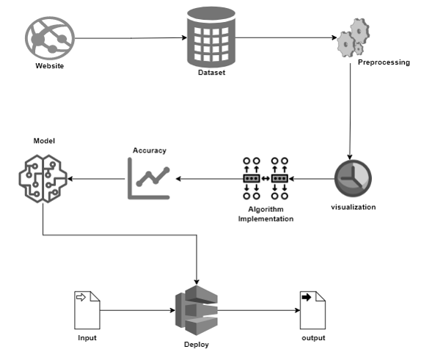
ARCHITECTURE

Slide 15
HARDWARE & SOFTWARE REQUIREMENTS
Hardware Requirements
Processor: Intel Core i3 or higher (recommended i5/i7 for faster processing)
RAM: Minimum 4GB (recommended 8GB or more for handling large datasets)
Storage: Minimum 10GB free space (recommended SSD for better performance)
GPU (Optional): NVIDIA GPU for faster machine learning model training
Network: Stable internet connection for accessing cloud-based resources (if applicable)

Slide 16
Software Requirements
Operating System: Windows 10 or later / Linux / macOS
Programming Language: Python (Latest stable version)
Development Tools: Jupyter Notebook (via Anaconda Navigator) for coding and testing
& Flask for web-based deployment
Libraries & Frameworks:
Machine Learning: Scikit-learn, KNN, SVM, Decision Tree
Data Processing: NumPy, Panda
Data Visualization: Matplotlib, Seaborn
Model Evaluation: SciPy, Statsmodels
Database (if required): MIMIC dataset (Real-world ICU patient data)

Slide 17
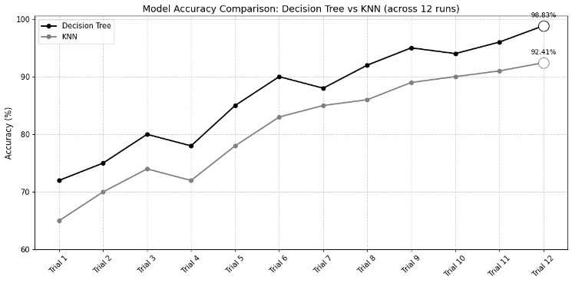
COMPARISON GRAPH:

Slide 18
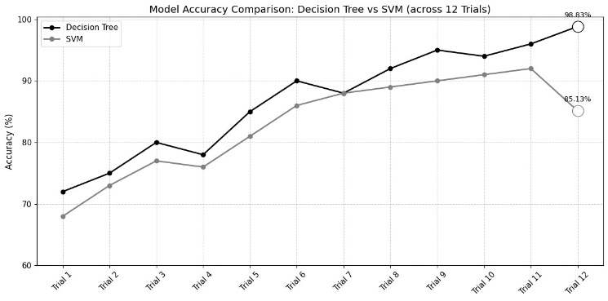
COMPARISON GRAPH:

Slide 19
CONCLUSION:
The ICU Patient Risk Level Monitoring System is being developed to enhance real-time patient risk assessment using machine learning techniques. By leveraging the MIMIC dataset, the system aims to improve early detection of critical conditions and assist healthcare professionals in making timely decisions. The integration of classification algorithms like KNN, SVM, and Decision Tree ensures a more accurate and scalable approach to ICU monitoring.
Currently, the project is in its development phase, with ongoing work on data preprocessing, model optimization, and real-time deployment. Efforts are being made to fine-tune the system by handling missing values, outliers, and feature selection to ensure reliable performance. Additionally, the Flask-based web deployment is being designed to provide an interactive and user-friendly interface for healthcare professionals.
As development progresses, further improvements will focus on enhancing model accuracy, integrating real-time data streaming, and optimizing computational efficiency. Future implementations may also include IoT-based patient monitoring and cloud integration to expand the system’s capabilities. Once completed, this project is expected to provide a scalable, data-driven solution for ICU risk monitoring, improving patient safety and hospital resource management.

Slide 20
FUTURE WORK AND ENHANCEMENTS:
Cloud Deployment for Real-time Automation
Implement cloud-based deployment to automate data streaming from ICU machines to the trained model.
Enable real-time predictions by directly feeding live patient data into the system.
Scalable & Distributed Processing
Use cloud services (Firebase, AWS, or Google Cloud) to ensure scalability and reliability of the system.
Implement server less functions or cloud-based APIs for automated data ingestion and model inference.
Integration with IoT & Healthcare Systems
Connect with hospital IoT devices for direct data flow into the prediction model.
Ensure secure and compliant integration with existing Electronic Health Records (EHRs).
Continuous Model Improvement
Implement automated model retraining using real-time ICU data for continuous accuracy improvement.
Leverage AI/ML pipelines for self-adaptive learning and enhanced performance.

Slide 21
THANK YOU

